Slide 1
Lecture 2/28:
Optimal Transport
Chad Atalla, Sai Aditya, Xiao Sai
Feb 28, 2019

Slide 2
Outline
Introduction to Optimal Transport
Monge OT
Transport Maps
Formulation
Problems
Kantorovich OT
Transport Plans
Formulation
Bernier’s Theorem
Applications
Sai Aditya, Xiao Sai, Chad Atalla Lecture 2/28 -

Slide 3
Introduction to Optimal Transport
Sai Aditya, Xiao Sai, Chad Atalla Lecture 2/28 -

Slide 4
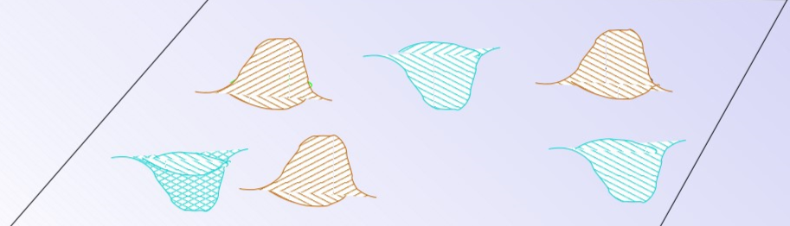
Introduction
What is Optimal Transport?
Transport one mass distribution to another optimally
Analogy: Move sand from piles to fill holes
Sai Aditya, Xiao Sai, Chad Atalla Lecture 2/28 -

Slide 5
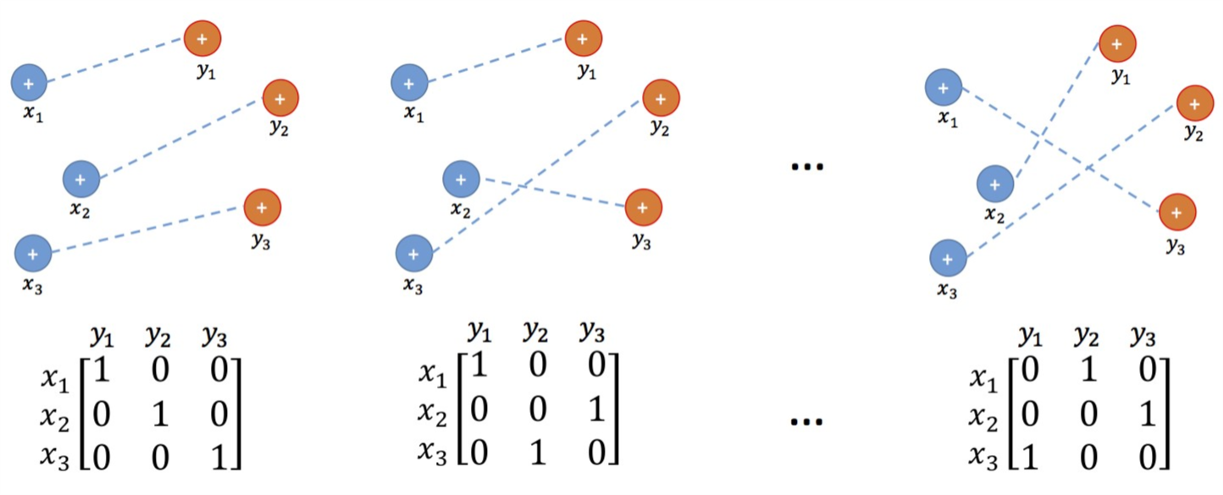
Introduction
Example:
Transport plans, simple discrete case
Sai Aditya, Xiao Sai, Chad Atalla Lecture 2/28 -

Slide 6
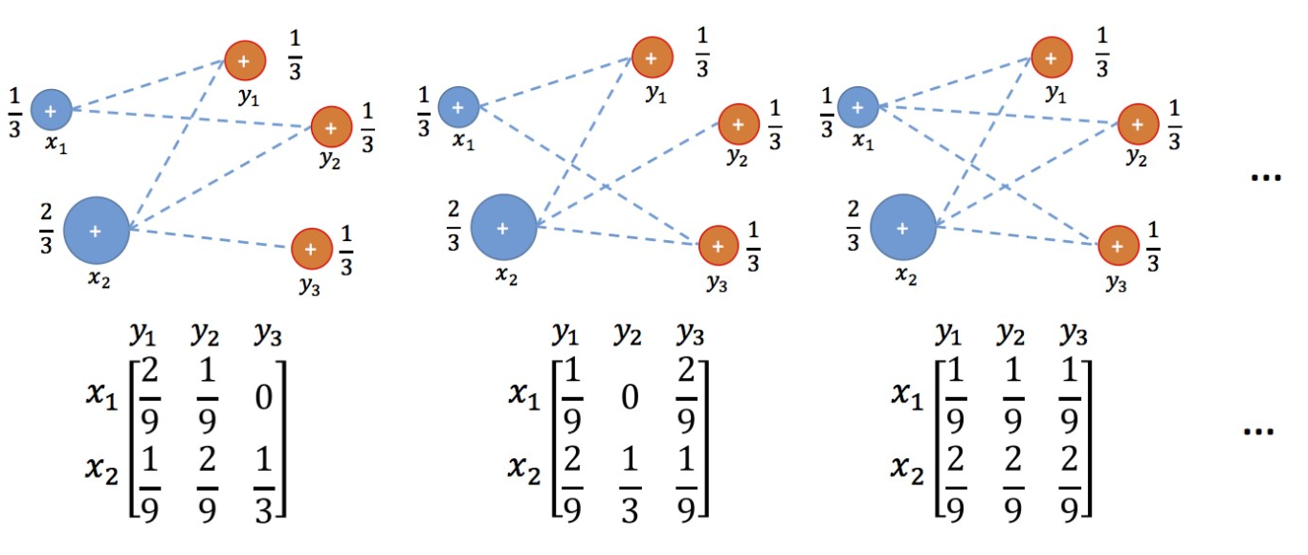
Introduction
Infinitely many transport plans
Sai Aditya, Xiao Sai, Chad Atalla Lecture 2/28 -

Slide 7
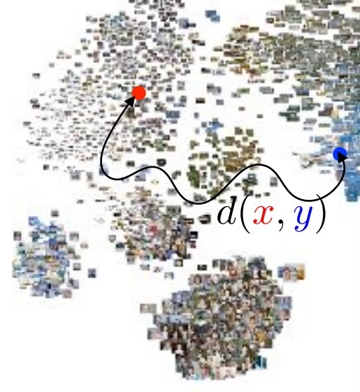
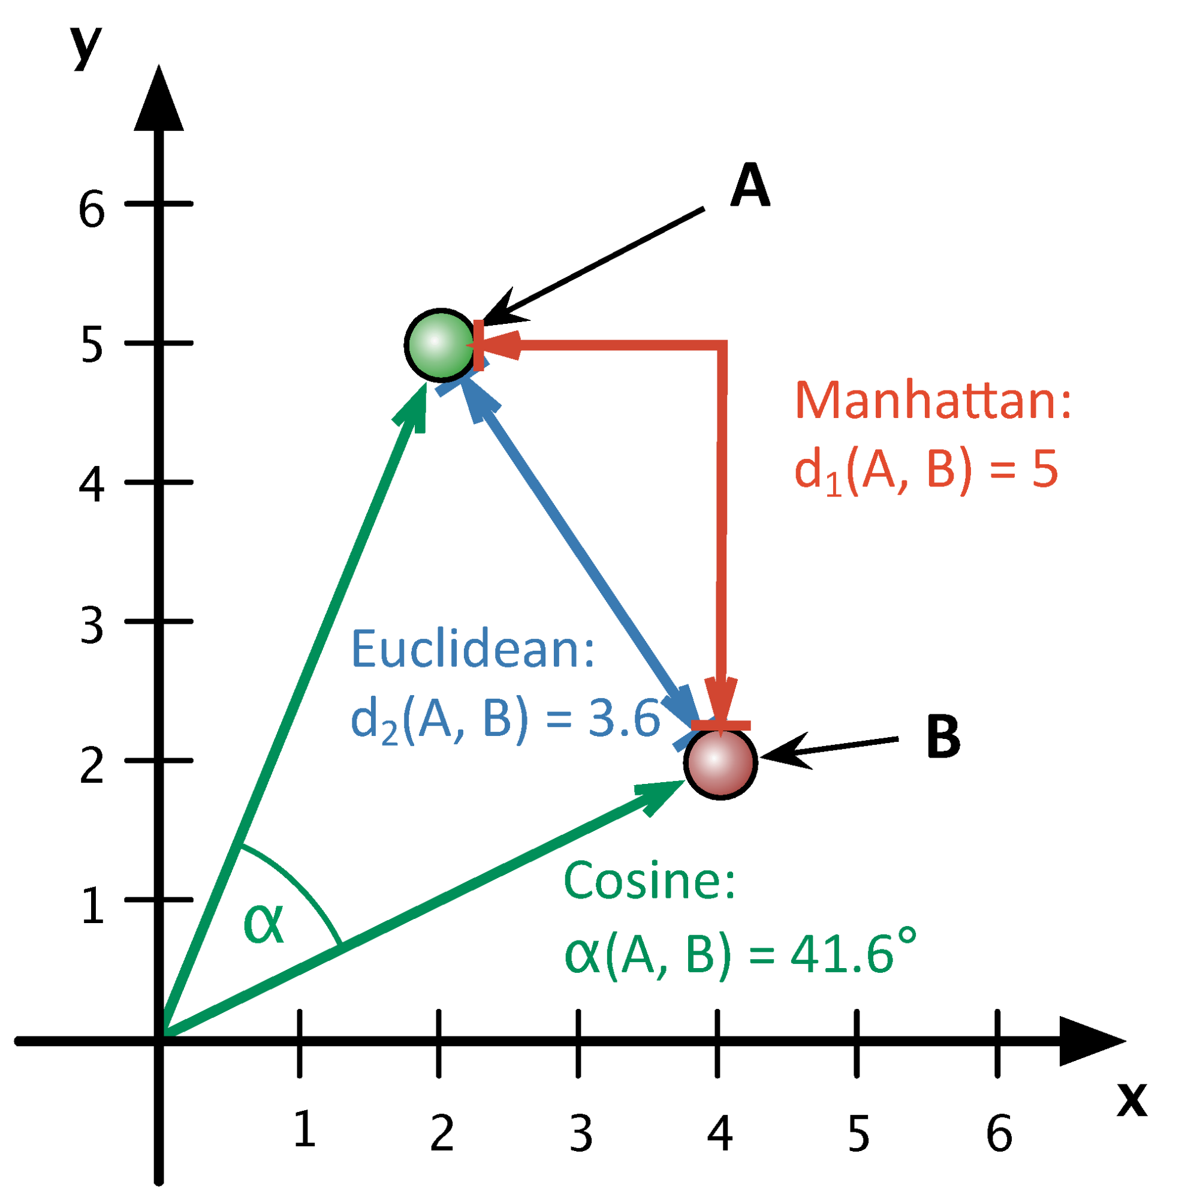
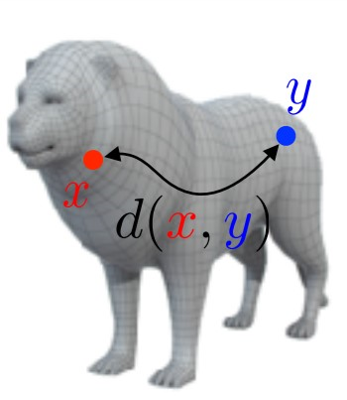
Introduction
“Transport one mass distribution to another optimally”
What does “optimally” mean?
We need a cost / distance metric!
Moving mass from x to y costs d(x,y)
https://optimaltransport.github.io/slides-peyre/TheoreticalFoundations.pdf
http://dh2016.adho.org/static/data/290.html
Sai Aditya, Xiao Sai, Chad Atalla Lecture 2/28 -

Slide 8
Introduction
Continuous Case
Move one mass distribution to another
https://optimaltransport.github.io/slides-peyre/TheoreticalFoundations.pdf
Sai Aditya, Xiao Sai, Chad Atalla Lecture 2/28 -

Slide 9
Monge Formulation
Sai Aditya, Xiao Sai, Chad Atalla Lecture 2/28 -

Slide 10
Monge Formulation
First formulation
Gaspard Monge, 18th Century
“The Note on Land Excavation and Infill”
Transport mass from space X to Y
Sai Aditya, Xiao Sai, Chad Atalla Lecture 2/28 -

Slide 11
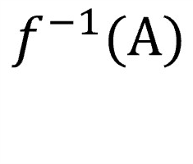
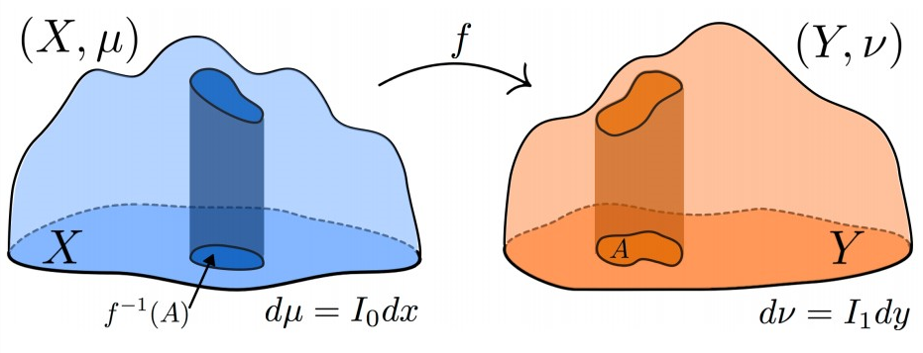
Transport Map
How do we transport mass from X to Y?
Specify a Transport Map
A Map 𝑓 : 𝑋 →𝑌
Mass measures 𝜇,𝑣 on spaces 𝑋,𝑌
Moves mass from to area 𝐴
Is that sufficient?
No!
Sai Aditya, Xiao Sai, Chad Atalla Lecture 2/28 -

Slide 12
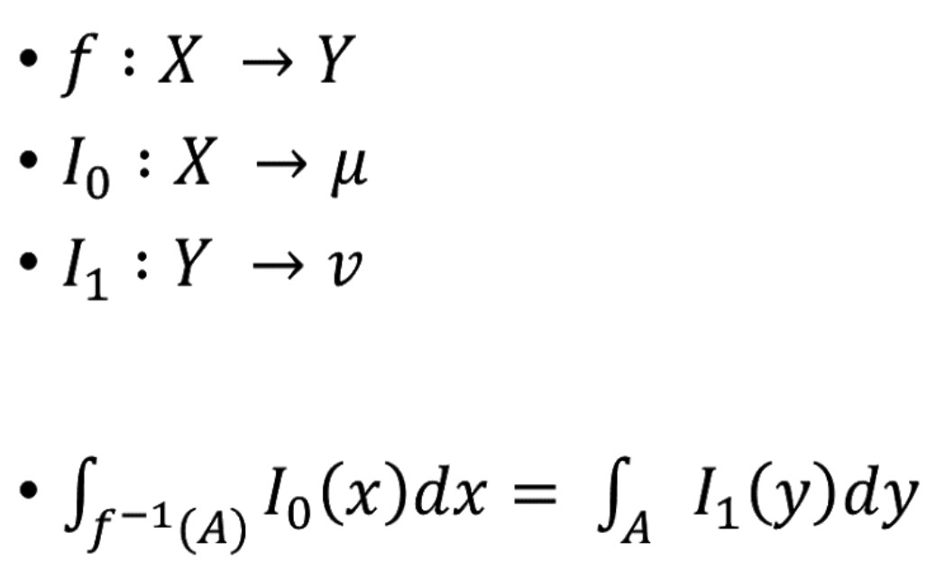
Transport Map
𝑓 is a Transport Map iff:
Sai Aditya, Xiao Sai, Chad Atalla Lecture 2/28 -

Slide 13
Monge Formulation
Find optimal Transport Map
𝑓 : 𝑋 →𝑌
𝑐(𝑥,𝑦) cost of transporting from 𝑥 to 𝑦
Minimize expected transport cost
Sai Aditya, Xiao Sai, Chad Atalla Lecture 2/28 -

Slide 14
Case: Euclidean Distance
Cost metric is often Euclidean Distance in applications
Both are nonlinear w.r.t. 𝑓
Difficult to optimize
Sai Aditya, Xiao Sai, Chad Atalla Lecture 2/28 -

Slide 15
Challenges
Only works on continuous measures!
Absolutely continuous
Compact support
𝑐(𝑥,𝑓(𝑥)) is convex
What if we have discrete data?
Transport particle cloud to Gaussian distribution?
Sai Aditya, Xiao Sai, Chad Atalla Lecture 2/28 -
Notes:
A function has compact support if it is zero outside of a compact set.A function has compact support if it is zero outside of a compact set. Compact set is some finite set on a space.

Slide 16
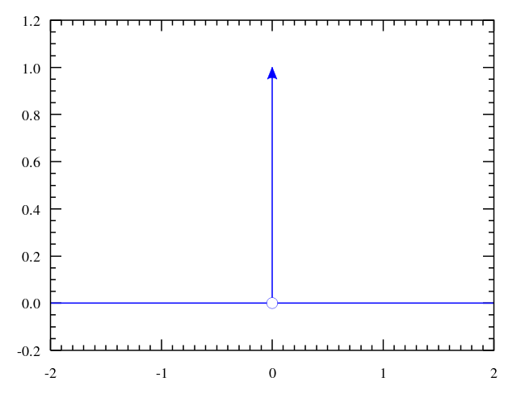
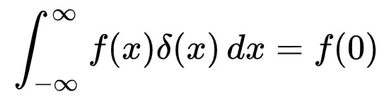
Challenges
Discrete Data
Adapt to Monge Formulation...
Represent with Dirac Measure
Sai Aditya, Xiao Sai, Chad Atalla Lecture 2/28 -

Slide 17
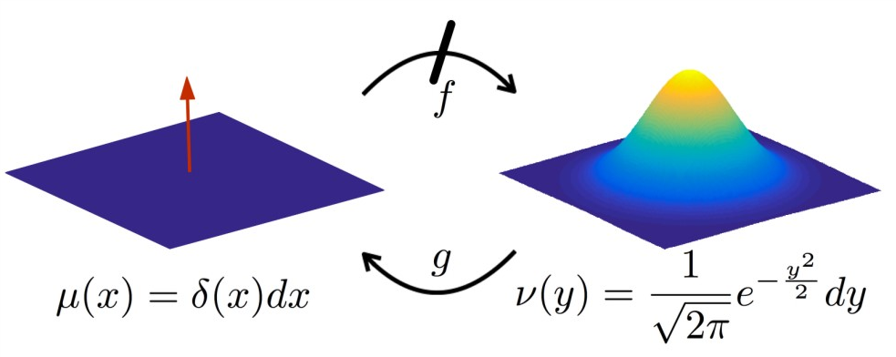
Challenges
Example of Failure:
Transport map does not exist
No splitting mass!
Sai Aditya, Xiao Sai, Chad Atalla Lecture 2/28 -

Slide 18
Limitation
Monge Formulation struggles with some discrete cases
Point cloud distribution
Cannot split mass (deterministic)
So...
Kantorovich Formulation – fix this!
Sai Aditya, Xiao Sai, Chad Atalla Lecture 2/28 -

Slide 19
Kantorovich Formulation
Sai Aditya, Xiao Sai, Chad Atalla Lecture 2/28 -

Slide 20
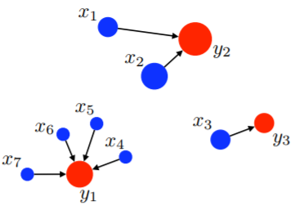
Monge
Monge formulation: intrinsically asymmetric
Non-linear structure
Sai Aditya, Xiao Sai, Chad Atalla Lecture 2/28 -

Slide 21
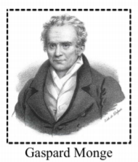
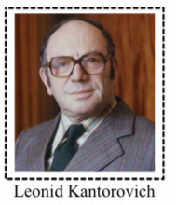
Kantorovich vs Monge
The key idea of Kantorovich formulation is to
relax the deterministic nature of transportation!
：Mass transportation should be deterministic
：Mass transportation should be probabilistic
Sai Aditya, Xiao Sai, Chad Atalla Lecture 2/28 -

Slide 22
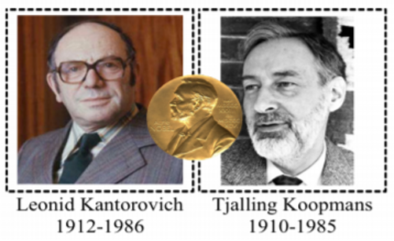
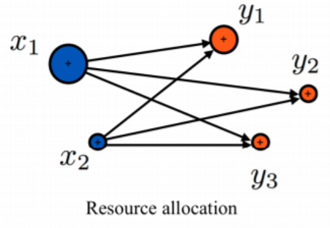
Kantorovich Formulation
Working on optimal allocation of scarce resources during World War II, Kantorovich revisited the optimal transport problem in 1942
In 1975, he shared the Nobel Memorial Prize in Economic Sciences with Tjalling Koopmans ”for their contributions to the theory of optimum allocation of resources.”
Sai Aditya, Xiao Sai, Chad Atalla Lecture 2/28 -

Slide 23
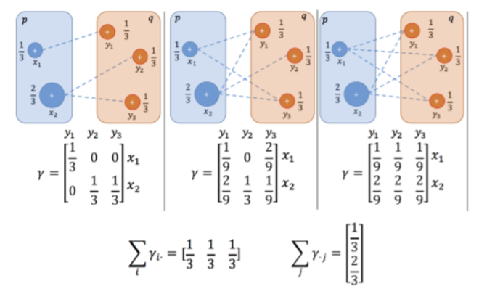
Transport Plan
A transport plan is a joint probability distribution with marginal distributions equal to the original distributions, p and q
Sai Aditya, Xiao Sai, Chad Atalla Lecture 2/28 -

Slide 24
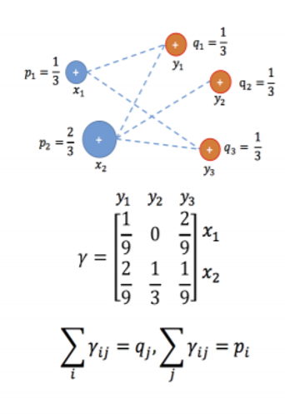
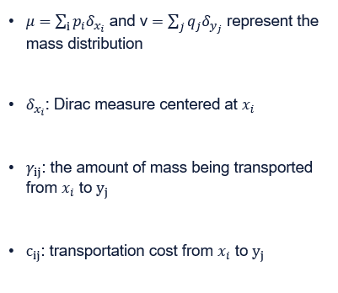
Transport Plan
Sai Aditya, Xiao Sai, Chad Atalla Lecture 2/28 -

Slide 25
Transport Plan
Then the problem is seeking the most efficient transport plan with the respect of cost c:
Sai Aditya, Xiao Sai, Chad Atalla Lecture 2/28 -

Slide 26
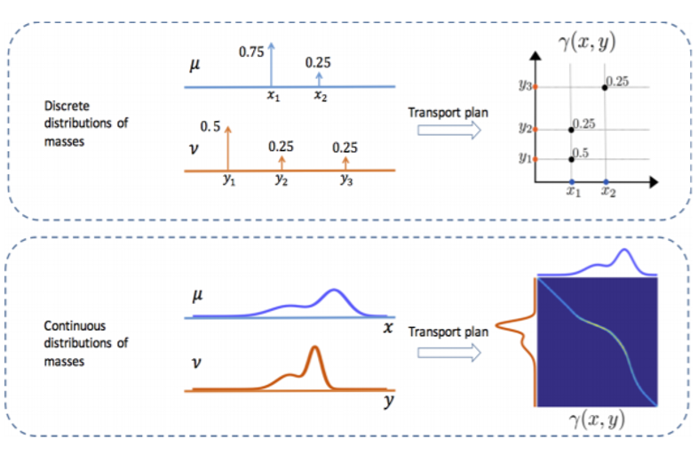
Continuums of Mass?
Sai Aditya, Xiao Sai, Chad Atalla Lecture 2/28 -

Slide 27
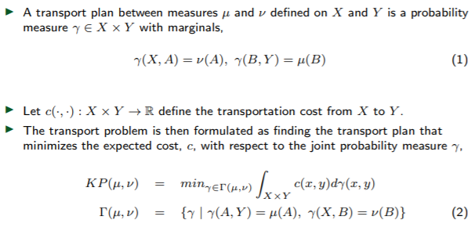
General Formulation
Sai Aditya, Xiao Sai, Chad Atalla Lecture 2/28 -

Slide 28
General Formulation
Discrete formulation(Earth mover’s distance):
General formulation:
Sai Aditya, Xiao Sai, Chad Atalla Lecture 2/28 -

Slide 29
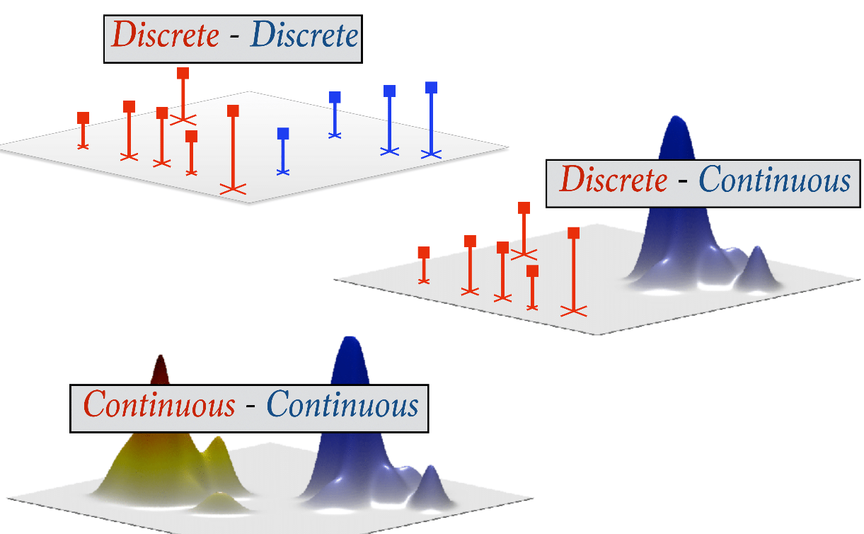
Kantorovich vs Monge
Sai Aditya, Xiao Sai, Chad Atalla Lecture 2/28 -

Slide 30
Brenier vs. Monge Cost
It turns out that Monge’s cost c(x, y) = |x − y| is among the hardest to deal with, due to its lack of strict convexity.
For this cost, the minimizer of the cost is not generally unique. Existence of solutions is tricky to establish.
The first ‘proof’ for Monge cost, relied on an unsubstantiated claim which turned out to be correct only in the plane M ±= R²
The situation for the quadratic cost c(x, y) = |x − y|² is much simpler, mirroring the relative simplicity of the Hilbert geometry of L₂.
Sai Aditya, Xiao Sai, Chad Atalla Lecture 2/28 -
Notes:
A Hilbert space is a vector space H with an inner product <f,g> such that the norm defined by |f|=sqrt(<f,f>)
turns H into a complete metric space. If the metric defined by the norm is not complete, then H is instead known as an inner product space.

Slide 31
Brenier’s Theorem
Brenier explained that there is one particular choice of cost function which
Is a unique optimal transport map, at least when 𝑋 = 𝑌 = R^{N}
It is a gradient of a convex function, which makes it suitable for a wide range of applications
The cost function would similar to earlier formulations as
only if 𝜇 is continuous and does not give mass to negligible sets and if 𝜇 and 𝜈 have finite second order moments.
With the cost in question is the square of the Euclidean distance:
c(x, y) = ∥x − y∥²
Sai Aditya, Xiao Sai, Chad Atalla Lecture 2/28 -
Notes:
second moment method is a technique used in probability theory and analysis to show that a random variable has positive probability of being positive. More generally, the "moment method" consists of bounding the probability that a random variable fluctuates far from its mean, by using its moments

Slide 32
Entropic Regularization
We have looked at the discrete case for OT earlier.
There exist combinatorial algorithms which can solve this in O(n³) time.
(network simplex and other min-cost flow algorithms)
OT problem is finding
d(𝜇, 𝜈) = min_{P ϵ𝜫(μ, 𝜈)}E_{P}(c(x, y))
This is not differentiable.
A faster and scalable approximate solution is needed.
Sai Aditya, Xiao Sai, Chad Atalla Lecture 2/28 -
Notes:
Pre flow push etc.
Applications with bipartitite matching as well

Slide 33
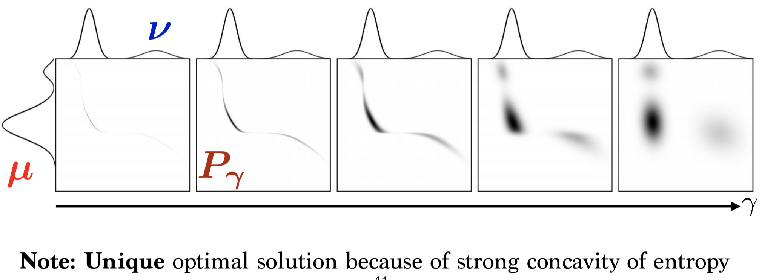
Entropic Regularization
Sai Aditya, Xiao Sai, Chad Atalla Lecture 2/28 -
Notes:
Discrete transport
Mxy is the cost
E(p) is the entropy

Slide 34
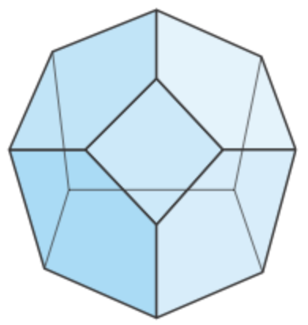
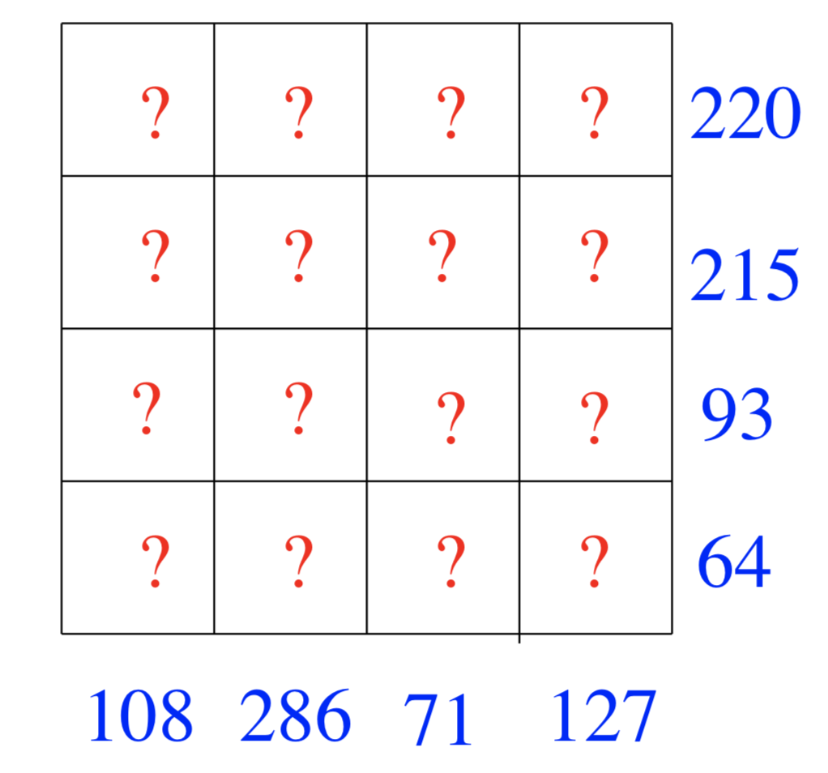
What’s P? (It’s a polytope)
Transportation Polytope:
A multi-index transportation polytope is the set of all real
d-tables that satisfy a set of given margins
Ex :The 2-way transportation polytope is the set of all possible tables whose row/column sums equal the margins.
Assignment Polytope
Sai Aditya, Xiao Sai, Chad Atalla Lecture 2/28 -
Notes:
This is for discrete setting
Polytope: In elementary geometry, a polytope is a geometric object with "flat" sides.
indicates how much of the mass {mu} is sitting in the {j}-th entry of {p} is transported to the {i}-th entry of {q}
Assignment Polytope : polytope of doubly stochastic matrices, or the perfect matching polytope

Slide 35
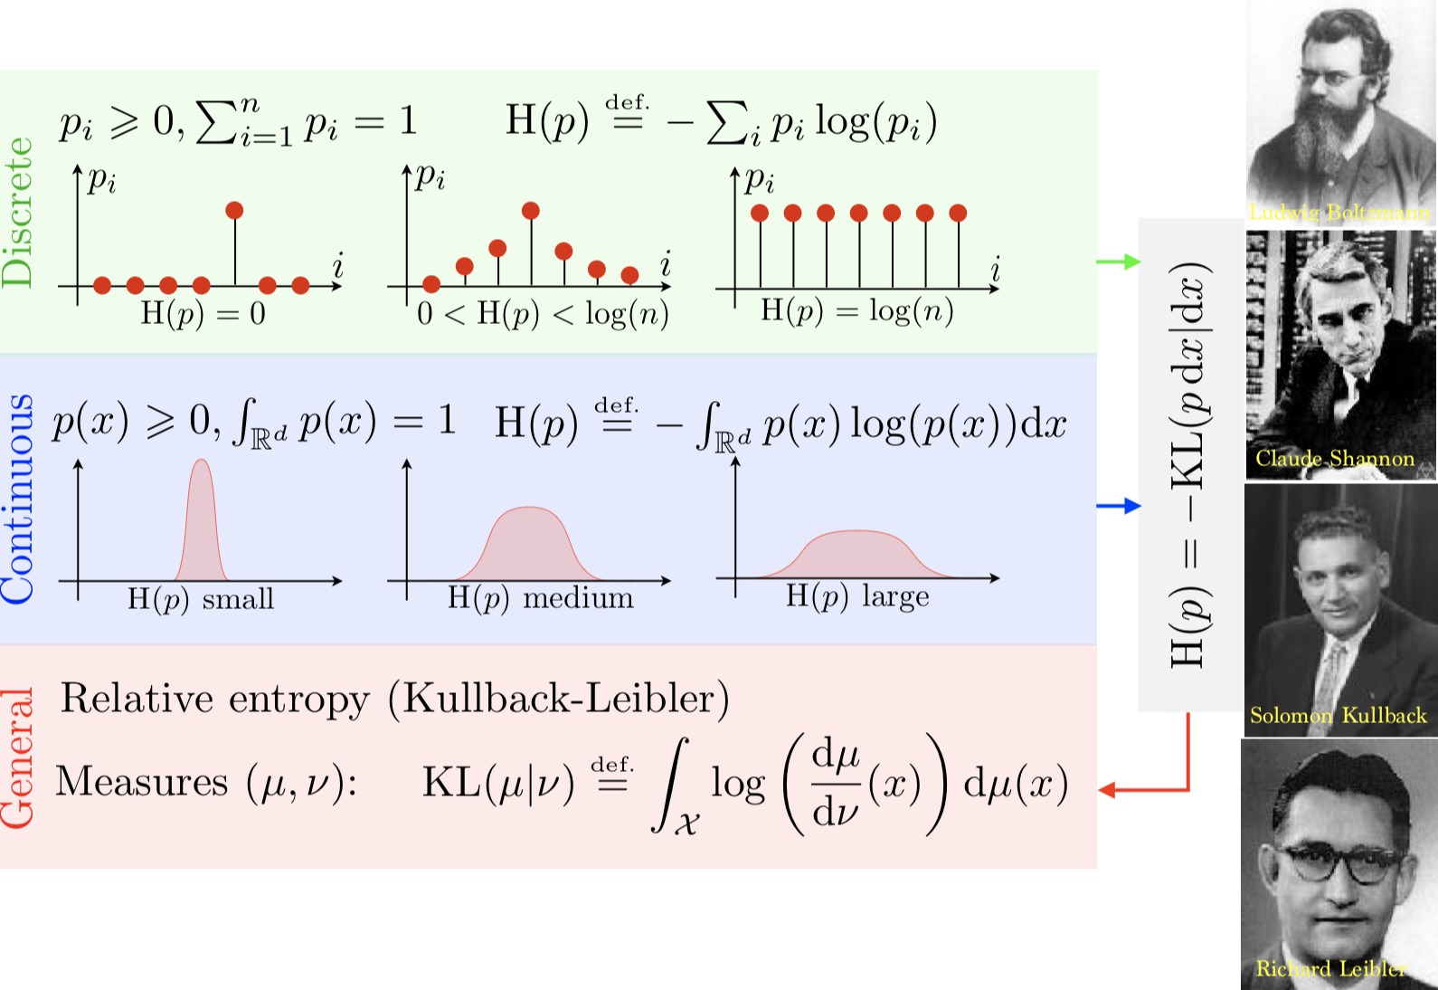
Entropic Regularization
Sai Aditya, Xiao Sai, Chad Atalla Lecture 2/28 -
Notes:
KL divergence is a measure of how one probability distribution is different from a second, reference probability distribution.

Slide 36
Applications
Sai Aditya, Xiao Sai, Chad Atalla Lecture 2/28 -

Slide 37
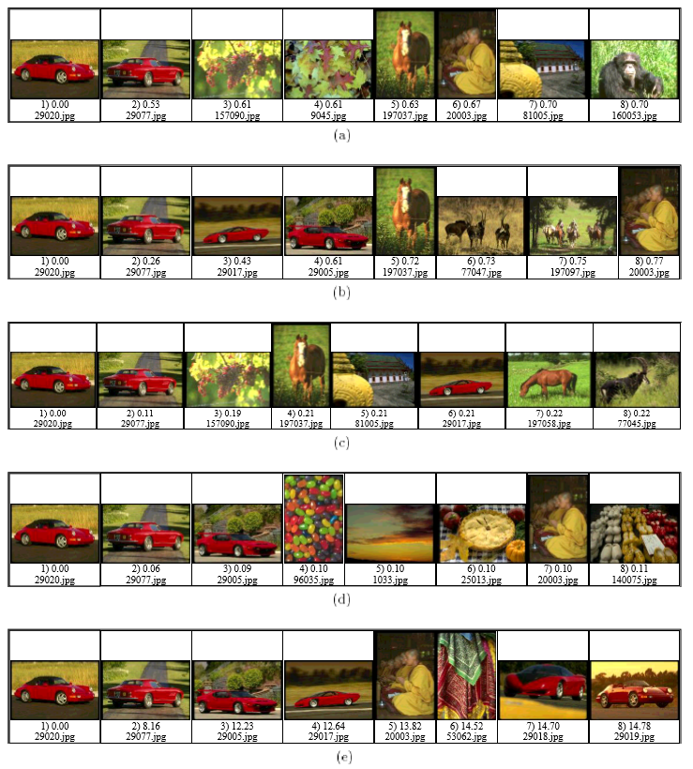
Image Retrieval
Sai Aditya, Xiao Sai, Chad Atalla Lecture 2/28 -

Slide 38
Image Retrieval
How to judge similarity of images?
Histograms vs Signatures
A histogram is a mapping from a set of d-dimensional integer vectors to the set of nonnegative reals. These vectors typically represent bins (or their centers) in a fixed partitioning of the relevant region of the underlying feature space.
Signatures: a set of feature clusters. Each cluster is represented by its mean (or mode), and by the fraction of pixels that belong to that cluster.
Sai Aditya, Xiao Sai, Chad Atalla Lecture 2/28 -

Slide 39
Image Retrieval
Sai Aditya, Xiao Sai, Chad Atalla Lecture 2/28 -

Slide 40
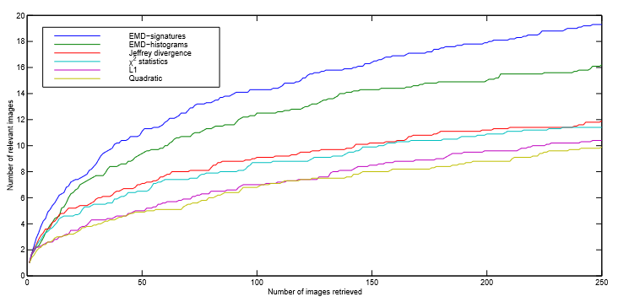
Image Retrieval
Sai Aditya, Xiao Sai, Chad Atalla Lecture 2/28 -

Slide 41
Word Mover’s Distance
How to judge similarity of sentences?
BLEU score?
BOW cosine similarity?
What if there are synonyms?
How similar are synonyms?
What if two words ≈ one?
Use Word2vec embedding space for word distance
Find Optimal Transport between sentences
Sai Aditya, Xiao Sai, Chad Atalla Lecture 2/28 -

Slide 42
Word Mover’s Distance
Formulating as Kantorovich Optimal Transport
What are X and Y?
A point represents a
sentence
Normalized Bag of Words
For n = |vocab|
n-1 dimensional simplex
Point or distribution?
Example on board
Sai Aditya, Xiao Sai, Chad Atalla Lecture 2/28 -
Notes:
generalization of the notion of a triangle or tetrahedron to arbitrary dimensions
point - distances like cosine dist.

Slide 43
Word Mover’s Distance
Formulating as Kantorovich Optimal Transport
Sai Aditya, Xiao Sai, Chad Atalla Lecture 2/28 -

Slide 44
Word Mover’s Distance
Formulating as Kantorovich Optimal Transport
𝑋,𝑌 𝑛−1 dimensional simplex
Sentence: distribution on 𝑋,𝑌
𝛾 : 𝑋 → 𝑌
𝑐(𝑥,𝑦) = || w₂v(𝑥) − w₂v(𝑦) ||₂
Sai Aditya, Xiao Sai, Chad Atalla Lecture 2/28 -

Slide 45
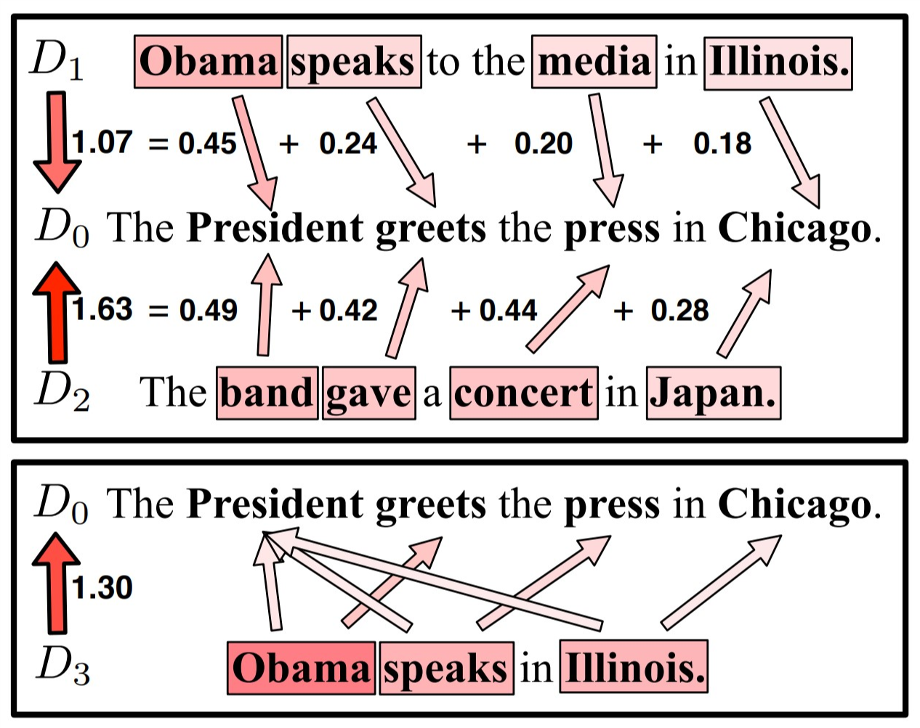
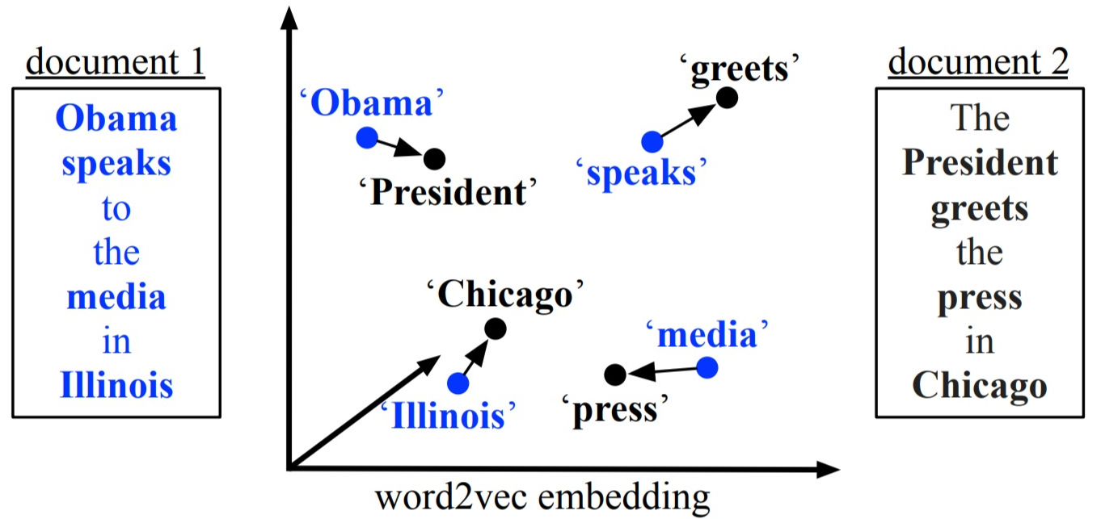
Word Mover’s Distance
Formulating as Kantorovich Optimal Transport
Sai Aditya, Xiao Sai, Chad Atalla Lecture 2/28 -

Slide 46
References
http://www-stat.wharton.upenn.edu/~steele/Courses/900/Library/ball-monotone-transportation.pdf
https://arxiv.org/pdf/1205.1099.pdf
https://www.slideshare.net/gpeyre/an-introduction-to-optimal-transport
https://www.ceremade.dauphine.fr/~carlier/IMA-transport-Lecture-Notes.pdf
http://proceedings.mlr.press/v37/kusnerb15.pdf
https://www.cs.cmu.edu/~efros/courses/LBMV07/Papers/rubner-jcviu-00.pdf
https://www.math.ucdavis.edu/~deloera/TALKS/20yearsafter.pdf
https://www.youtube.com/watch?v=-NExCdSVyAY
https://regularize.wordpress.com/2015/09/17/calculating-transport-plans-with-sinkhorn-knopp/
Sai Aditya, Xiao Sai, Chad Atalla Lecture 2/28 -

Slide 47
Thank You
Sai Aditya, Xiao Sai, Chad Atalla Lecture 2/28 -

Slide 48
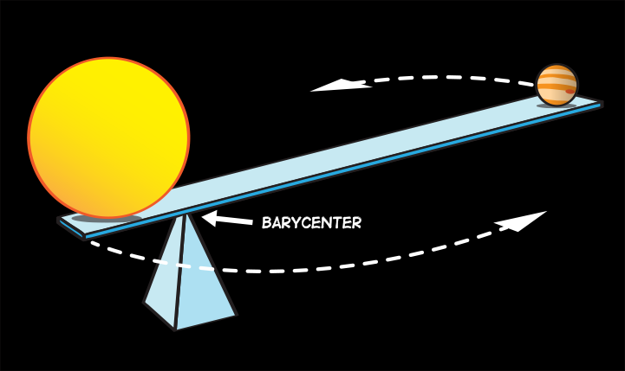
Extra: Barycenters
https://arxiv.org/pdf/1310.4375.pdf
“Wasserstein barycenter, is the measure that minimizes the sum of its Wasserstein distances to each element in that set”
https://spaceplace.nasa.gov/barycenter/en/
Sai Aditya, Xiao Sai, Chad Atalla Lecture 2/28 -

Slide 49
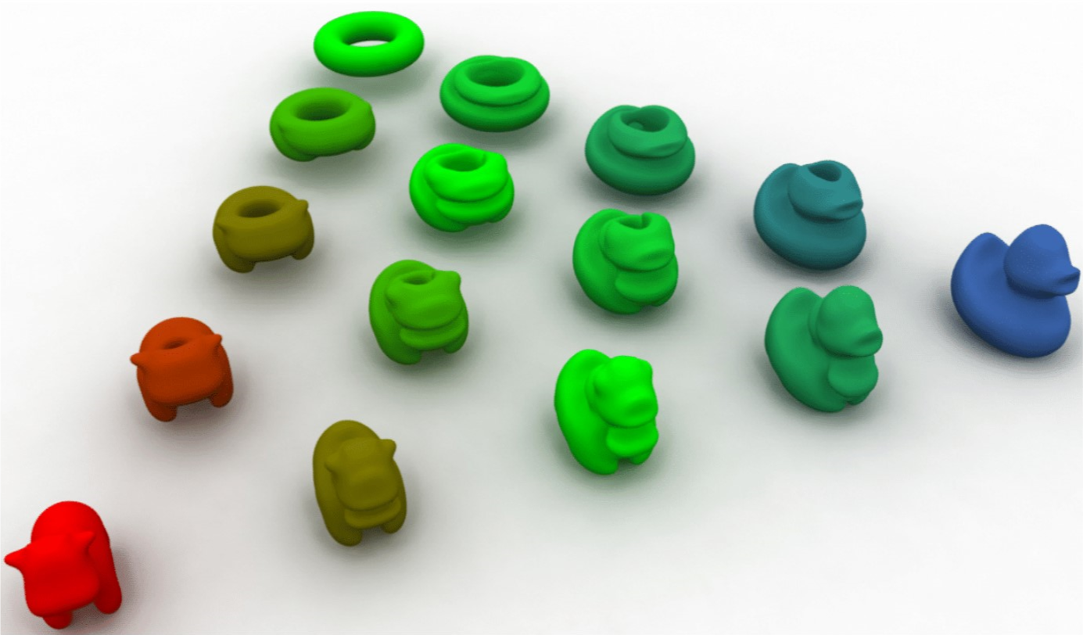
Extra: Barycenters
Barycenter between 3D objects?
Represent as a mass distribution over 3D space...
https://spaceplace.nasa.gov/barycenter/en/
Sai Aditya, Xiao Sai, Chad Atalla Lecture 2/28 -

